Slide 2
Relocation Control Process

Slide 3
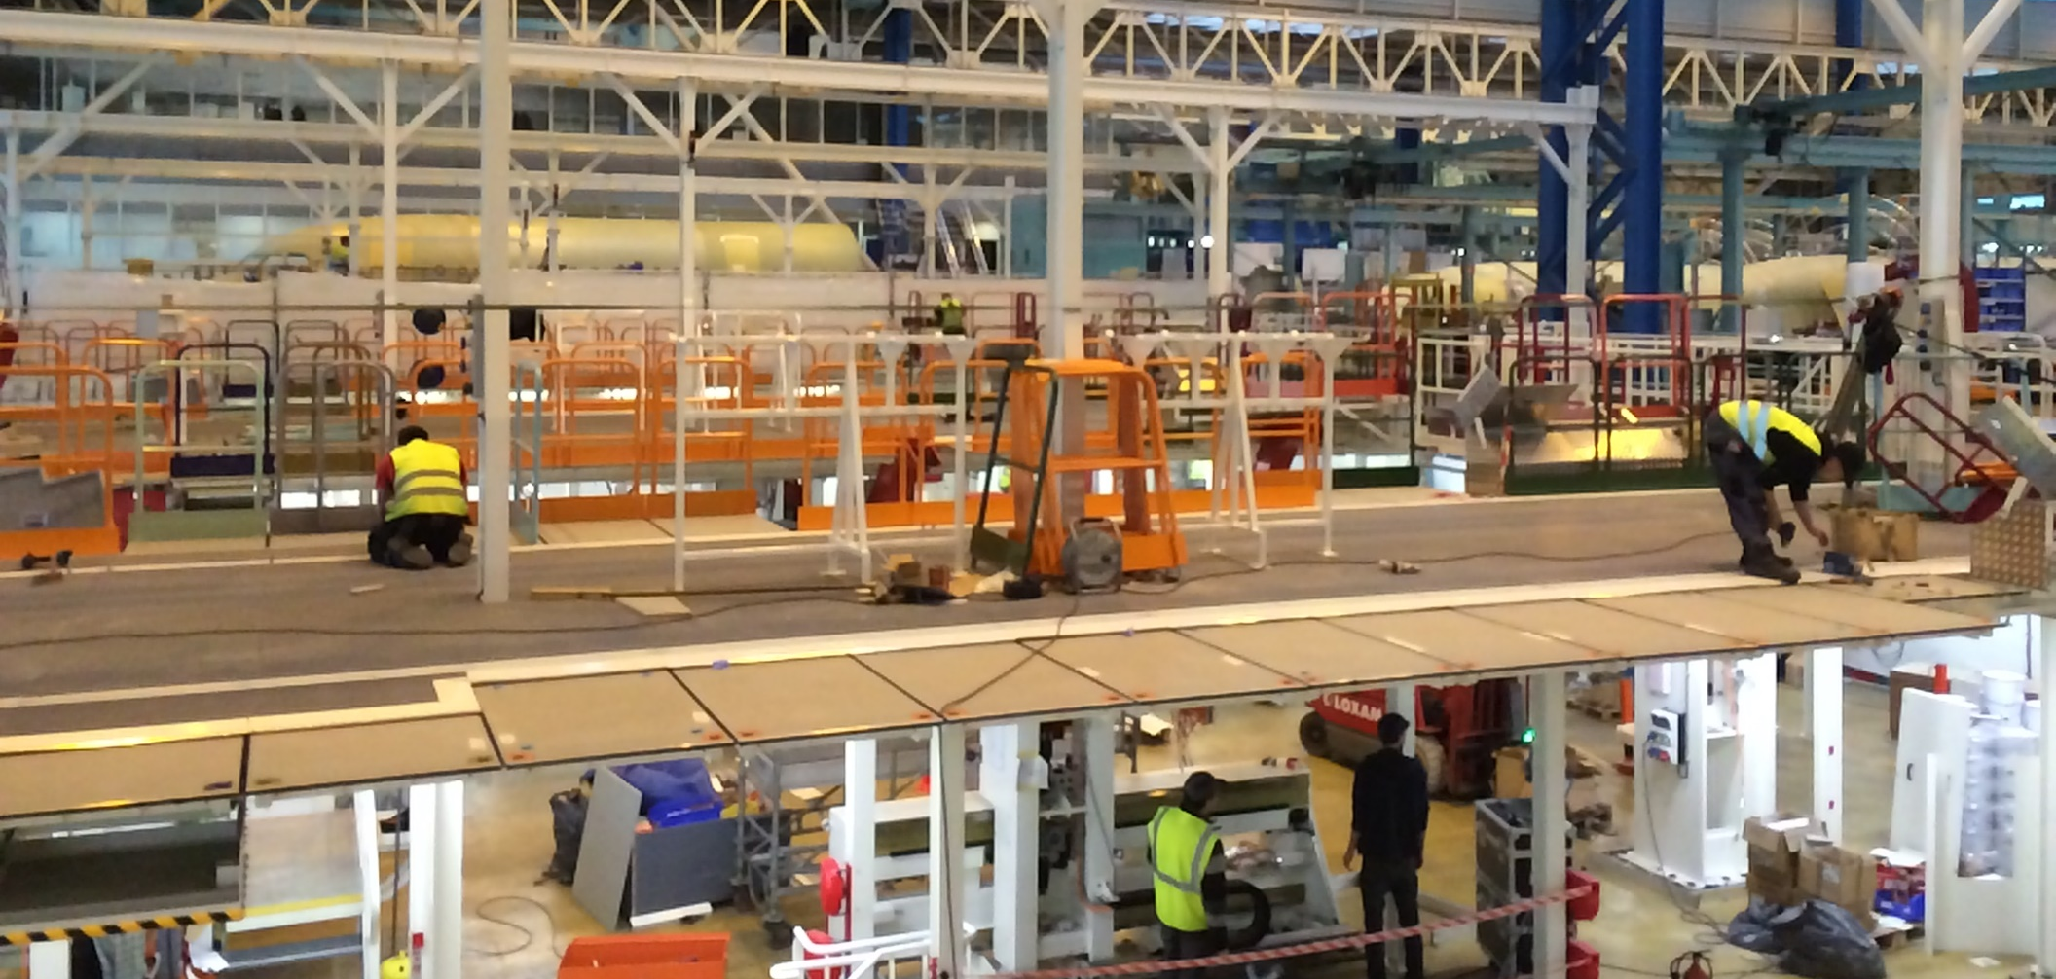
How we work?
Kontrola procesu relokacji

Slide 4
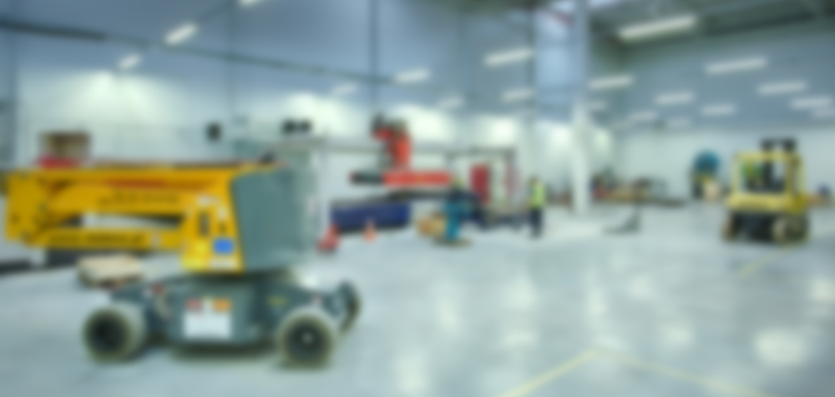
How we work?
Preparing a Plant Area for the Move
Equipment Disassembly Procedures
Loading Procedures
Truck Scheduling
Unloading Procedures & Equipment Inspections
Destination Plant Layout and equipment locations
Reassembly of the equipment
Start up and testing
Kontrola procesu relokacji

Slide 5
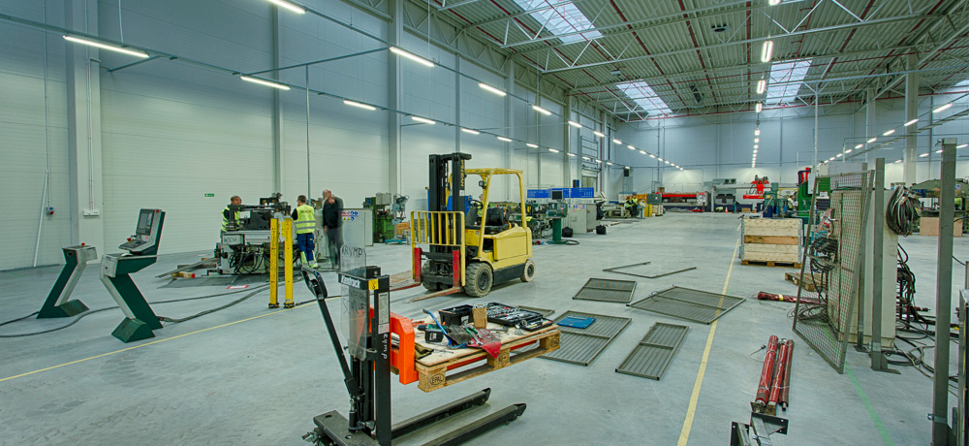
Step 1: Preparing a Plant Area for the Move
Kontrola procesu relokacji

Slide 6
Step 1: Preparing a Plant Area for the Move
Identify all equipment, jigs, spare parts, tools and inventory to be moved
Take pictures of the area
Complete a physical inventory of the area, tagging and recording all of the assets to be moved
Move all scrap, obsolete equipment, jigs, tools, etc. into a predetermined disposal area
Kontrola procesu relokacji

Slide 7
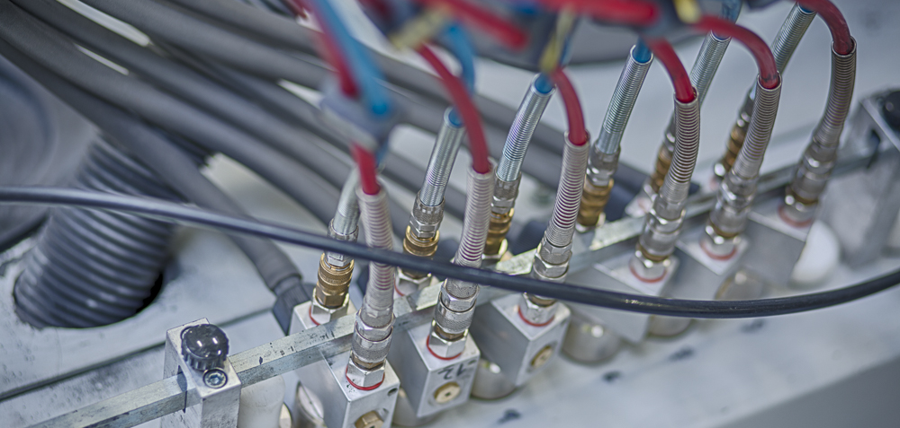
Step 2: Equipment Disassembly Procedures
Kontrola procesu relokacji

Slide 8
Step 2: Equipment Disassembly Procedures
Check equipment drawing (if available) and redline any differences in the equipment configuration
Lock-out-Tag-out the equipment
Disconnect all Utilities – power supplies,, compressors, air supplies, water supplies, waste systems (e.g.. chip removal equipment) Tag equipment where the utilities are connected..
Ensure that all tools required for the disassembly are available
Empty all hydraulic oil, lubricating oils, water, etc. from the equipment
Disassemble equipment taking efforts to mark or tag separated parts so they can be reassembled once in Poland. Take photos as appropriate..
Note any special connections to floors, walls or columns for stability
Kontrola procesu relokacji

Slide 9
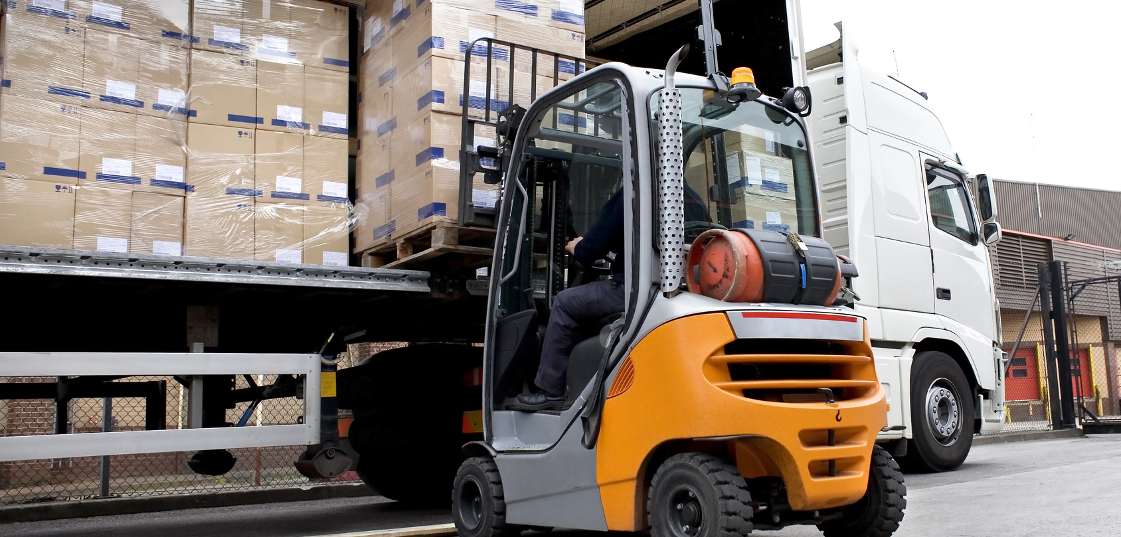
Step 3: Loading Procedures
Kontrola procesu relokacji

Slide 10
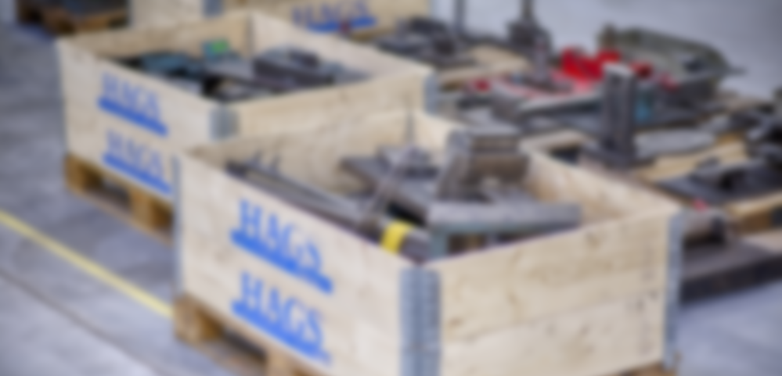
Step 3: Loading Procedures
Each truckload should have a list of the component parts loaded, including asset/inventory tag numbers
Take photos of the load before the truck leaves the Origin plant. This is valuable in case the load is damaged in transit to the new Destination Plant
Kontrola procesu relokacji

Slide 11
Step 4: Truck Scheduling
Kontrola procesu relokacji

Slide 12
Step 4: Truck Scheduling
A daily schedule will be maintained for all truck traffic in and out of the Origin site
Kontrola procesu relokacji

Slide 13
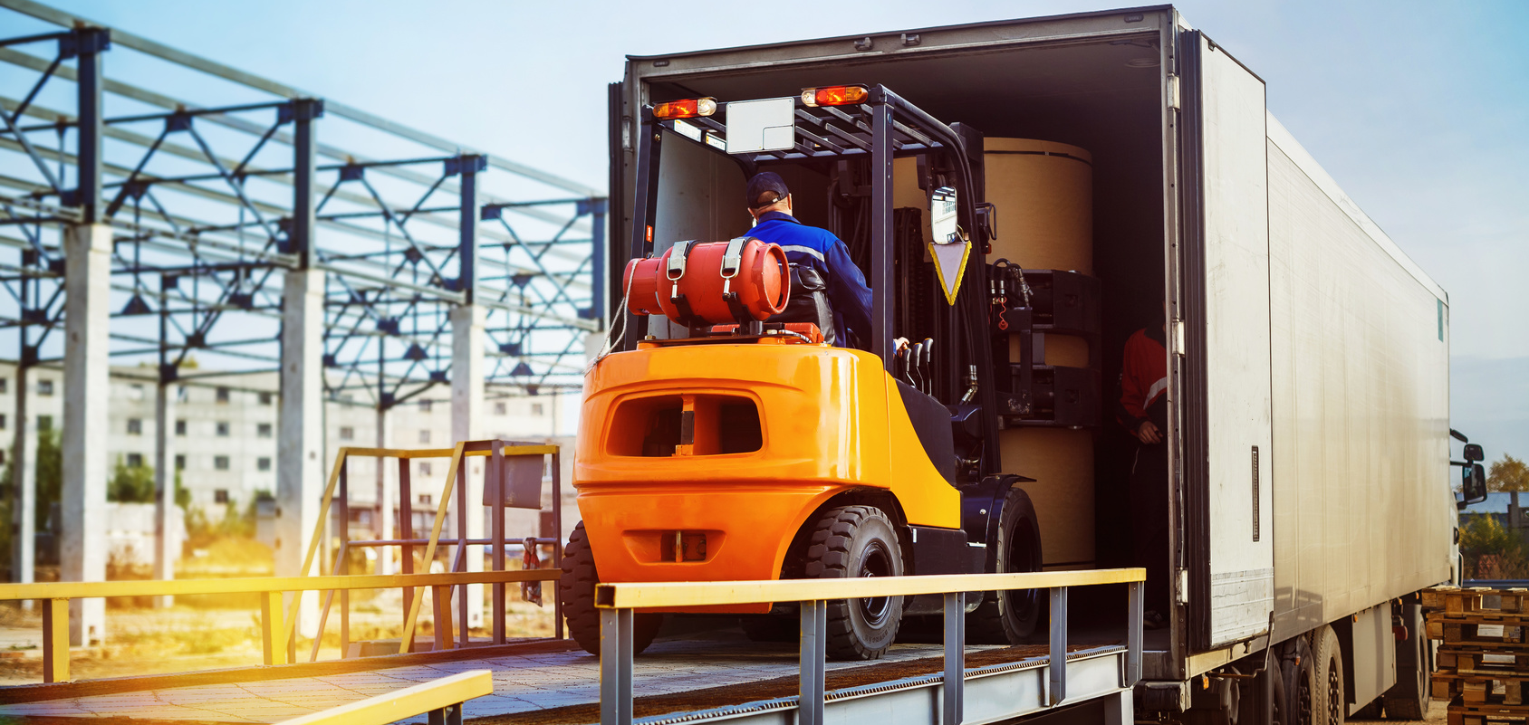
Step 5: Origin Site Receiving Schedule & Procedures
Kontrola procesu relokacji

Slide 14
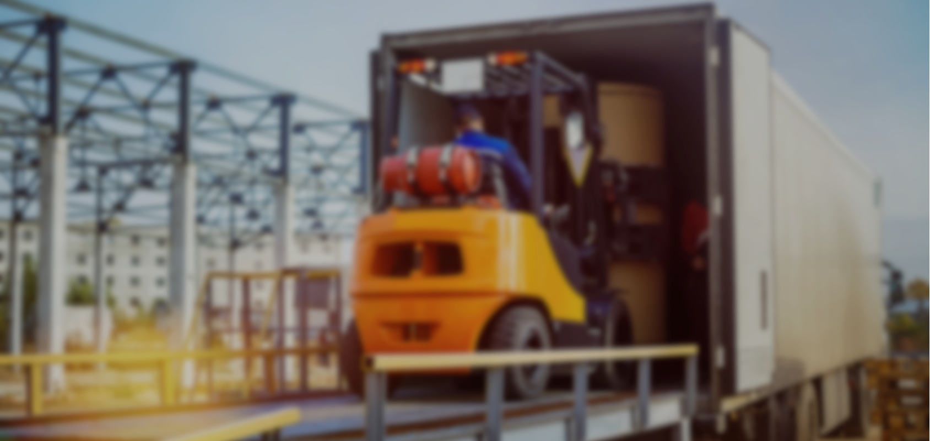
Step 5: Origin Site Receiving Schedule & Procedures
A schedule of expected truck arrival times will be reviewed each morning and updated throughout the day
Staff or contractors will be scheduled to unload the trucks, put away inventory, tools, jigs, etc. and begin reassembly of the equipment.
Tools and mobile equipment will be on hand at the appropriate time and location to unload the trucks
Kontrola procesu relokacji

Slide 15
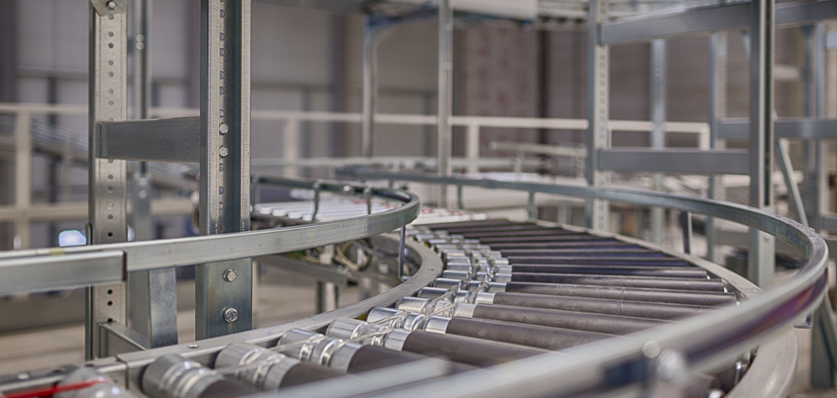
Step 6: Reassembly of the equipment
Kontrola procesu relokacji

Slide 16
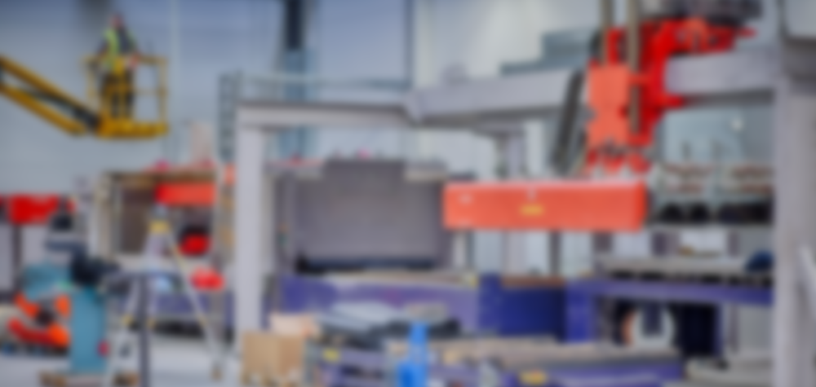
Step 6: Reassembly of the equipment
Ensure that all tools required for the assembly are available
Re-assemble equipment taking efforts to realign separated parts. Utilize photos taken in Origin Site and any available equipment diagrams as guides.
Note any special connections to floors, walls or columns for stability
Level equipment
Connect all Utilities – power supplies,, compressors, air supplies, water supplies, waste system
Fill all reservoirs for hydraulic oil, lubricating oils, water, etc. required to operate the equipment
Lockout/tag out equipment prior to start up
Kontrola procesu relokacji

Slide 17
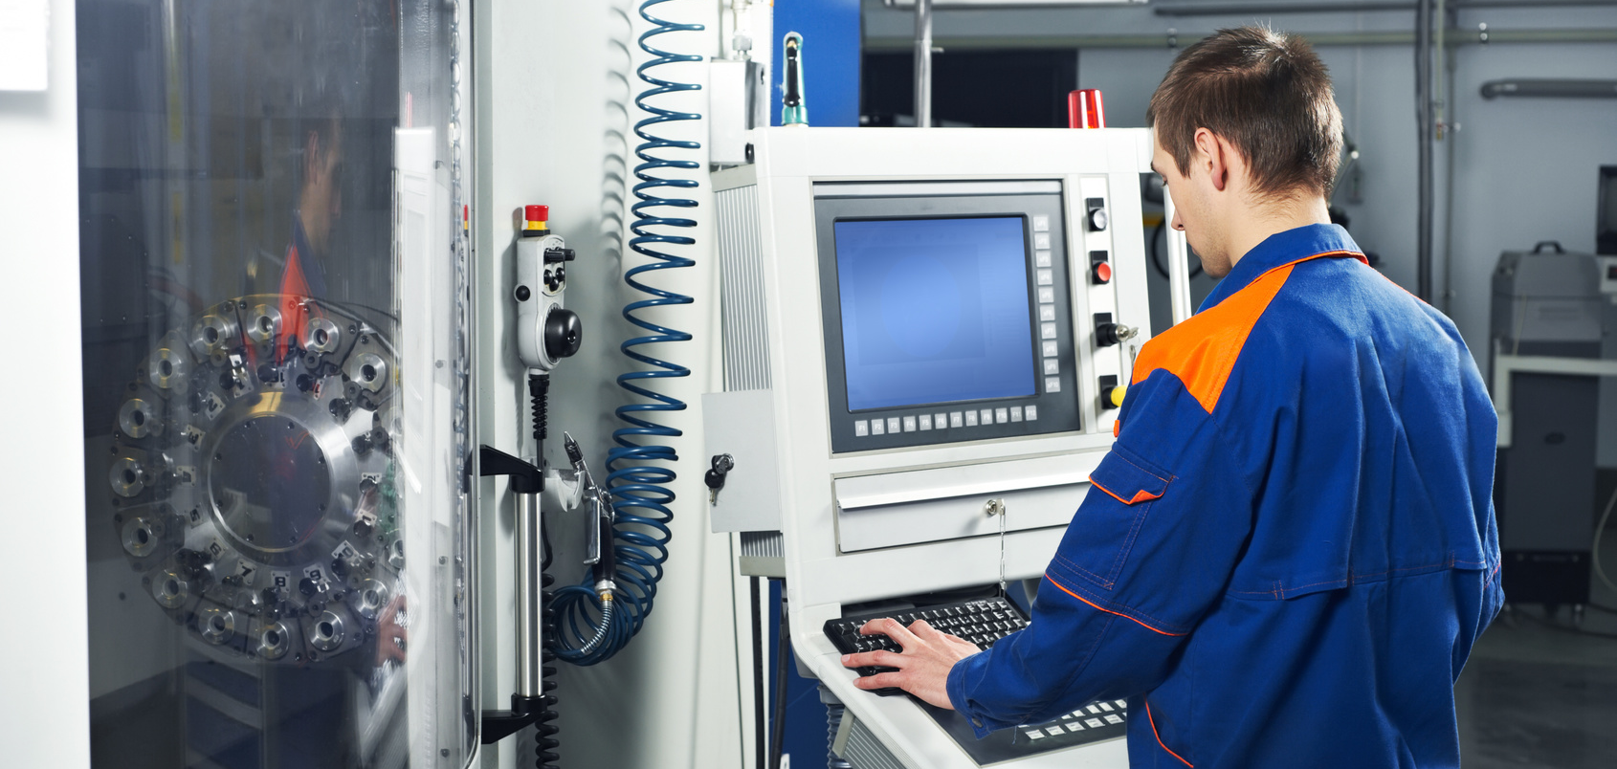
Step 7: Quality System Designed and Implemented
Kontrola procesu relokacji

Slide 18
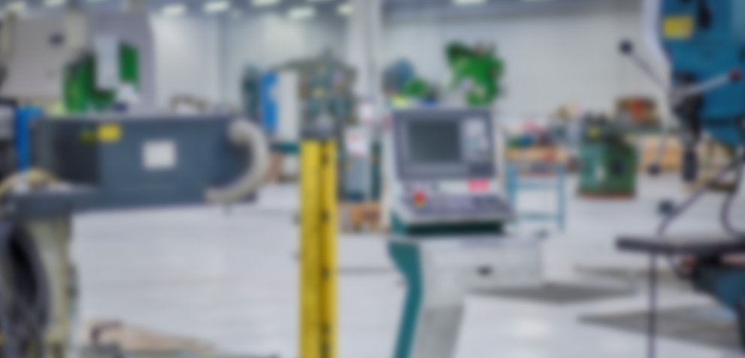
Step 7: Quality System Designed and Implemented
Before the Equipment can be certified as producing product correctly, we need to install a pre-production quality system. This includes inspection procedures, product specifications/drawings, and the visual work instructions for each piece of equipment/each product
Kontrola procesu relokacji

Slide 19
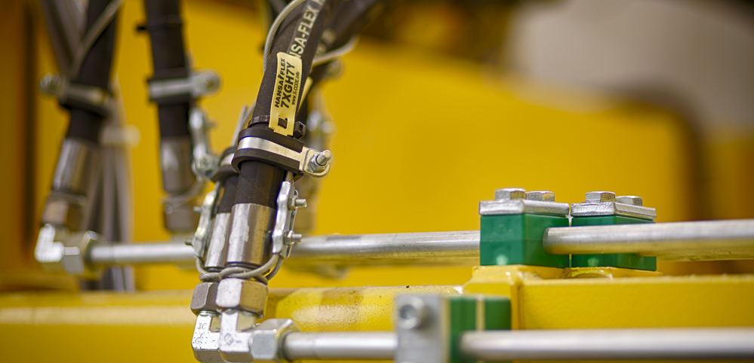
Step 8: Start up and testing
Kontrola procesu relokacji

Slide 20
Step 8: Start up and testing
Collect visual work instructions and machine instructions created at the Origin plant for this piece of equipment and store near the equipment.
Bring in an experienced operator(from Origin site or trained in Origin site)
Set equipment parameters/ load programs/complete any additional equipment setups required
Unlock Equipment
Make the 1st few parts under controlled conditions
Visually inspect each part produced. Apply any additional quality procedures .
Identify defects
Conduct root cause analysis if necessary
Correct equipment setup
Kontrola procesu relokacji

Slide 21
Major Projects
Origin Site | Destination Site | Type
Aneby, Sweden, Hags AB | Sosnowiec, Poland, Hags Poland | Hags Production Plant
Ekenassjon, Sweden, Proton Finishing | Hillerstorp, Sweden, Proton Finishing | Cataphoretic Coating Line
Le Mans, France, Agriel | Le Mans, France, Sanders Ouest | Fodder Production Line
Ekenassjon, Sweden, A-Lackering | Savsjo, Sweden, A-Lackering | Powder Coating Line
Markaryd, Sweden, Nibe | Kaunas, Lithuania, Pelly | Powder Coating Line
Laaperanta, Finnland, Paroc | Hallekis, Sweden, Paroc | Paroc Production Plant
Enschede, Netherlands, Unimeta | Kaunas, Lithuania, Pelly | Powder Coating Line
Kontrola procesu relokacji

Slide 22
Major Projects
Origin Site | Destination Site | Type
Manresa, Spain, CEMSA | Saudi Arabia | Linia do produkcji dachówek
Aros, Norway, Industrilackering | Radomir, Bulgaria, AQ Electric | Powder Coating Line
Markaryd, Sweden, Nibe | Hillerstorp, Sweden, Pulverlacken | Powder Coating Line
Mjolby, Sweden, Termodyn | Tranas, Sweden, Rostfria | Powder Coating Line
Jarpas, Sweden, LVI | Stenkullen, Sweden, Silab | Powder Coating Line
Jarbo, Sweden, Cibes | Gavle, Sweden, Cibes | Powder Coating Line
Kontrola procesu relokacji

Slide 23
We are looking forward to help you to transfer production line or heavy equipment to the destination site using our experience and know - how

